Slide 1
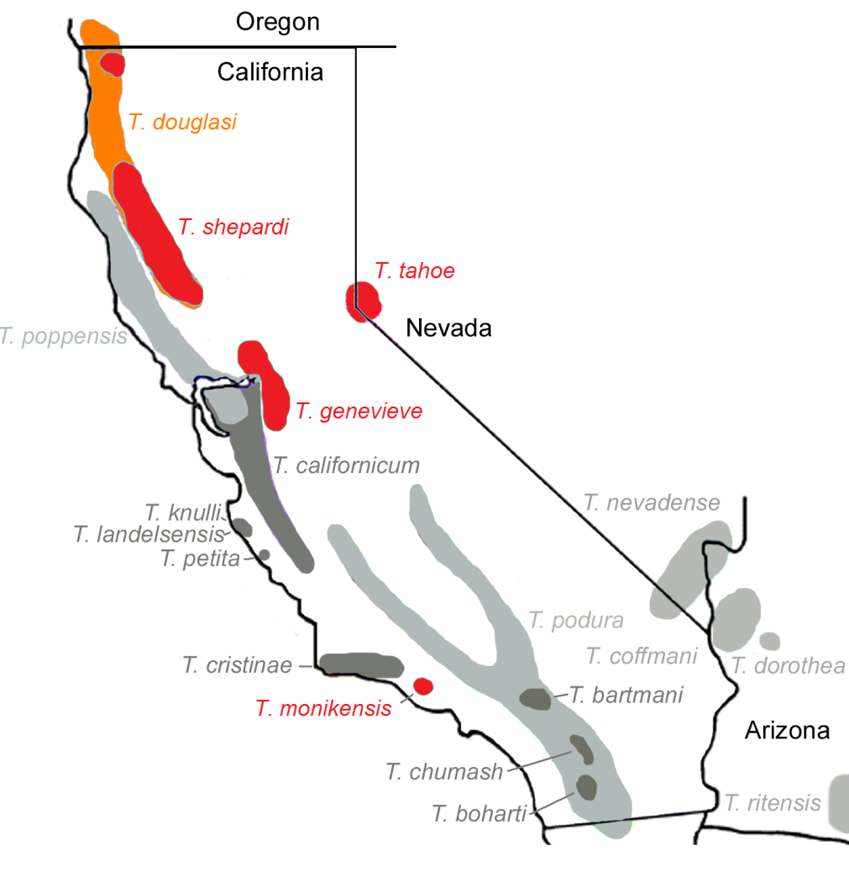
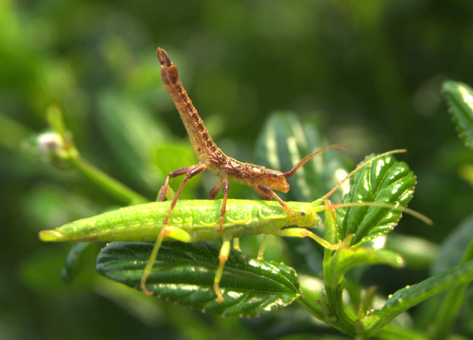
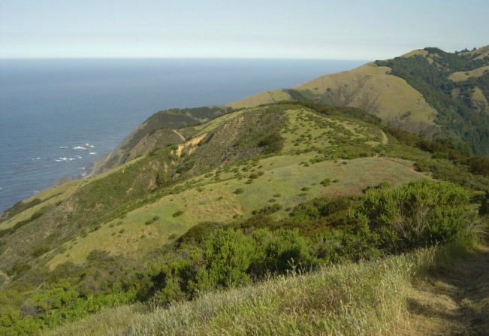
Model system: Timema stick insects
21 described species
Endemic to western US and Mexico

Slide 2
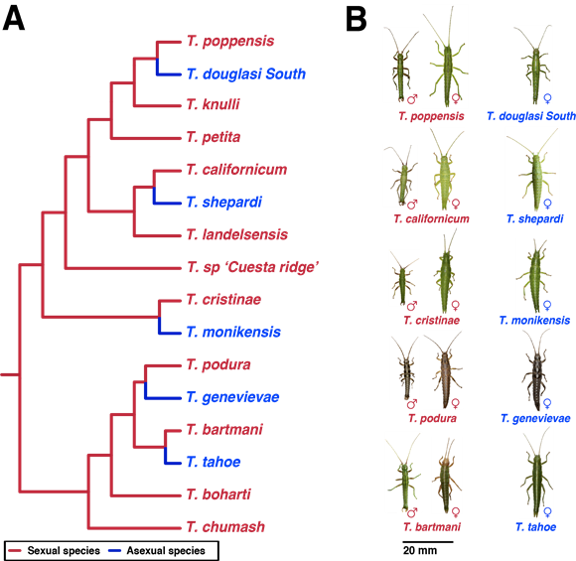
Model system: Timema stick insects
~30myr

Slide 3

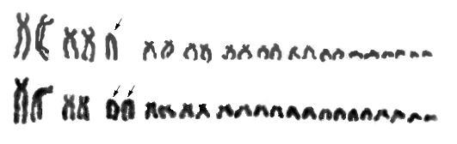

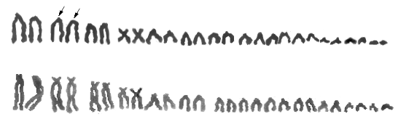
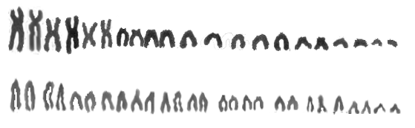
Model system: Timema stick insects
XX: XO sex determination
2n = 24/23
2n = 26/25
~30myr
2n = 28/27
(Tge: 27, 21)
2n = 22/21, 24/23, or 26/25

Slide 4
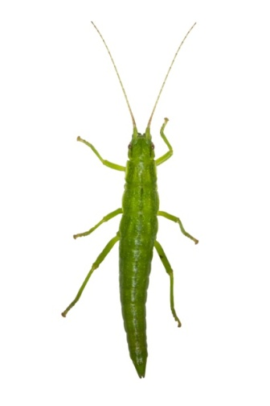
Functionally apomictic parthenogenesis
-10 msat markers
-250 offspring/ species
Heterozygosity fully maintained
(<0.33% recombination)
Notes:
Upper 95% CI for rate of recombination

Slide 5
Model system: Timema stick insects
~30myr

Slide 6
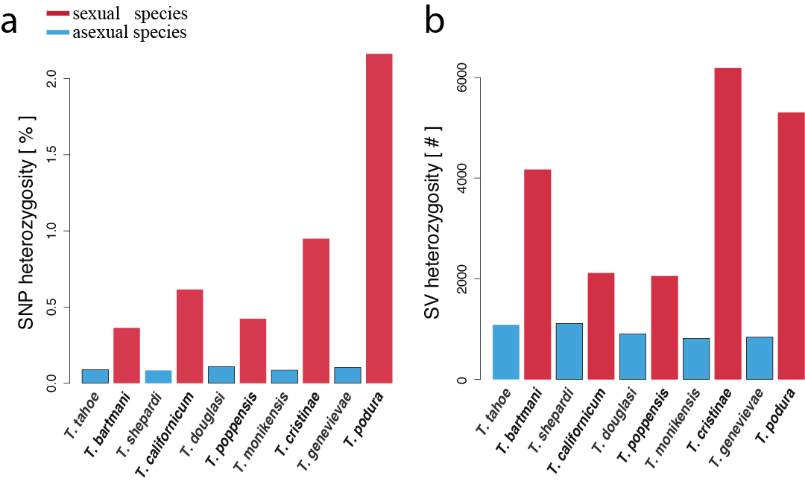
Heterozygosity

Slide 7
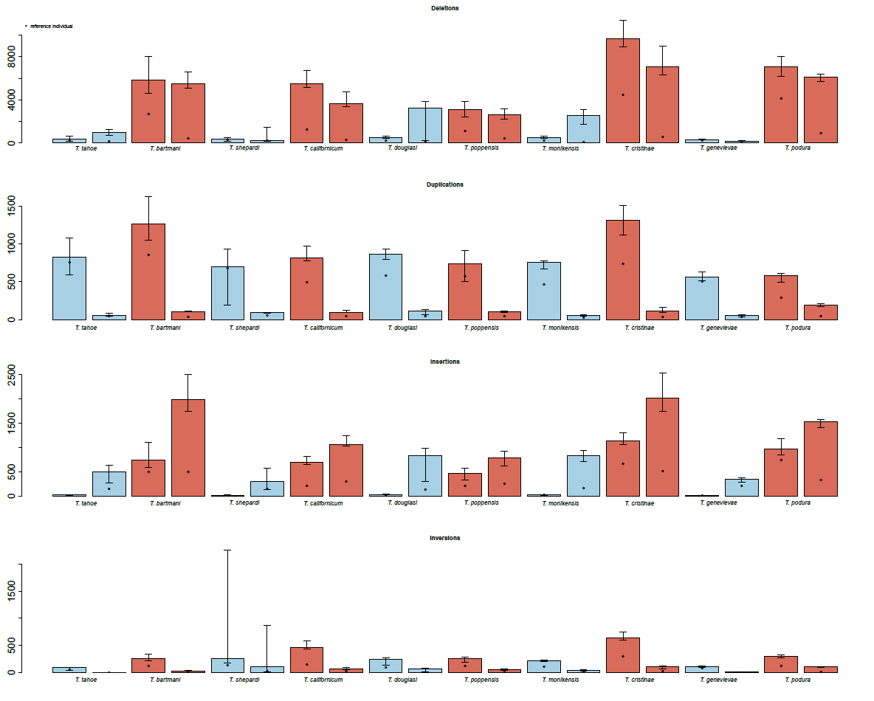
Heterozygosity
Deletions
Duplications
Insertions
Inversions
Notes:
First bar heterozyg, second homozyg

Slide 8
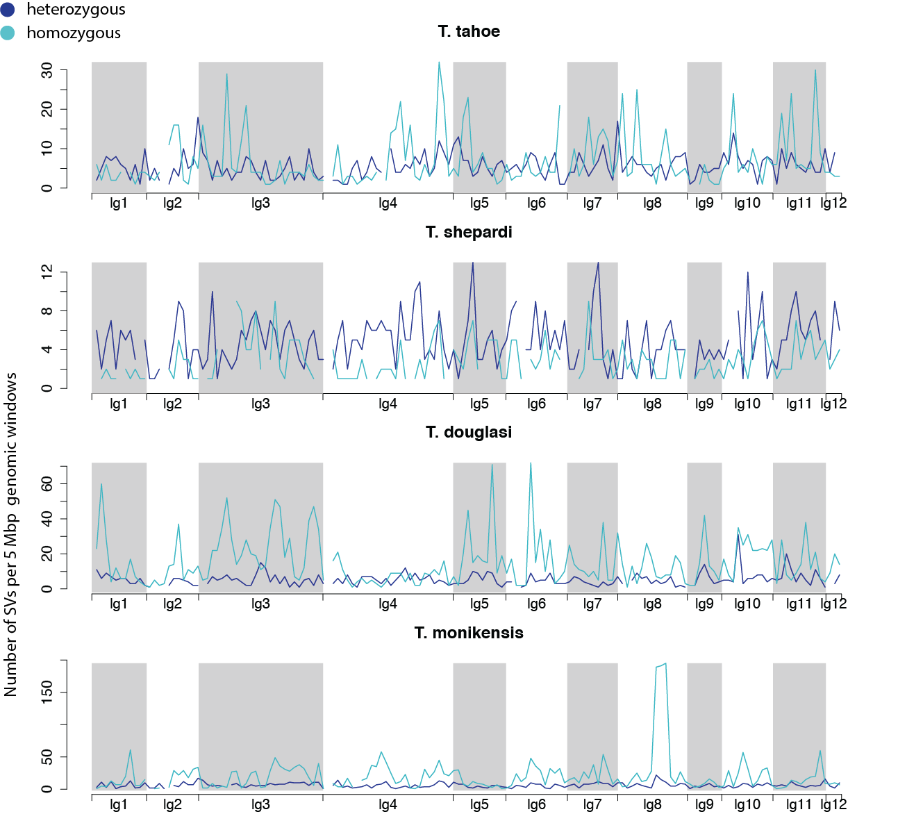
Heterozygosity
Jaron et al. in prep

Slide 9
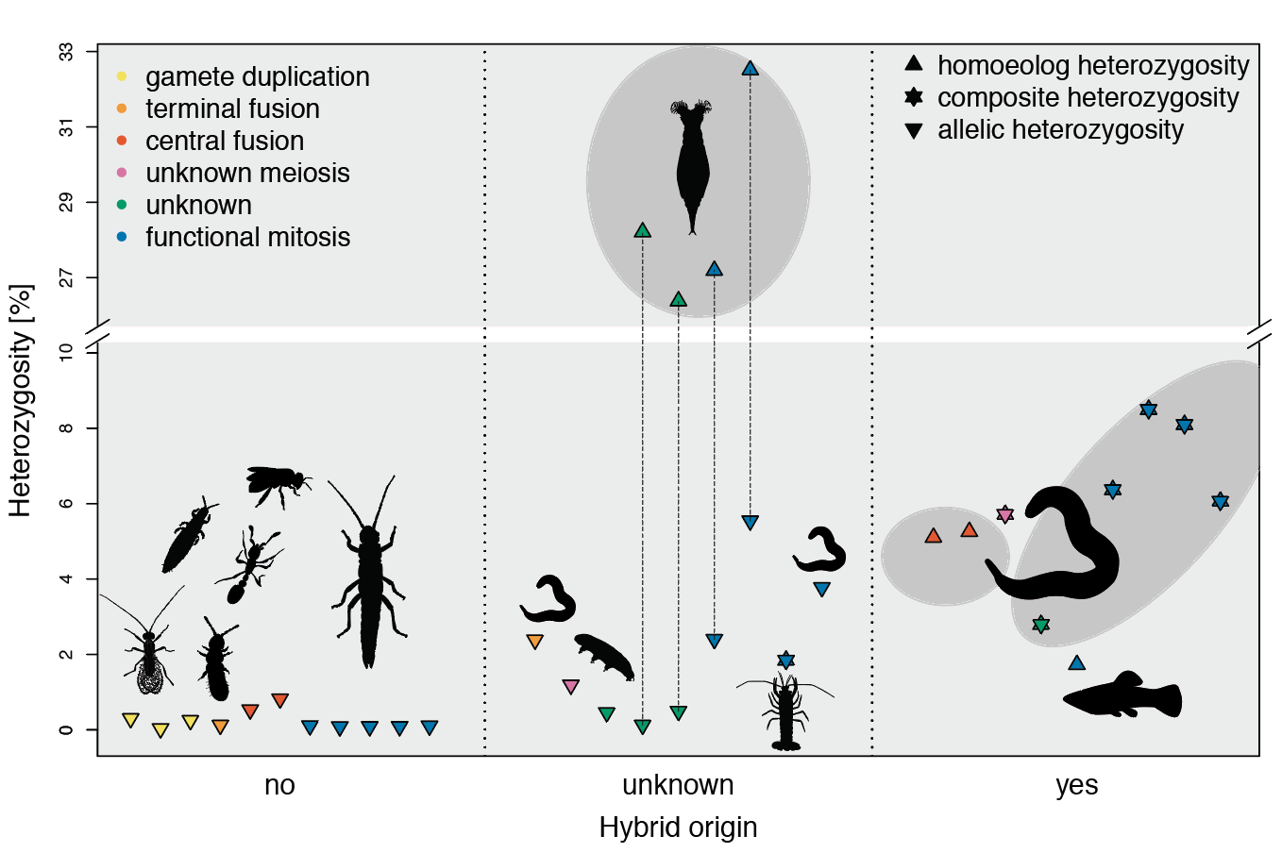
Asexual animals are “completely” homozygous except if of hybrid origin
Jaron et al. bioRxiv. 2018:10.1101/497495

Slide 10
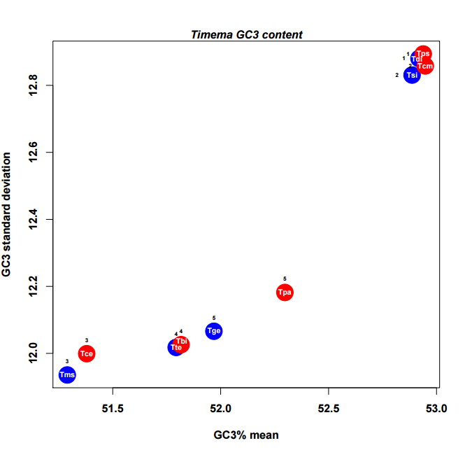
GC-biased gene conversion
sex
asex
GC3 standard deviation
GC3% mean

